Slide 1

CYCLISTIC DATA ANALYSIS
ASARA VYSHNAVI

Slide 2
Introduction
The Cyclistic case study is part of the Google Professional Data Analytics Certification
Cyclistic, launched in 2016, offers a bike-share program with 5,824 geotracked bicycles and 692 stations across Chicago. The program features flexible pricing plans, including single-ride, full-day passes, and annual memberships. Casual riders use single-ride or day passes, while annual subscribers are Cyclistic members. The marketing strategy has focused on general awareness and broad consumer appeal.

Slide 3

Contents
Project Purpose
The Questions
Analysis Summary
Final Conclusion

Slide 4
Purpose
One of the project's scenarios involves making decisions using data. To determine the forthcoming marketing campaign and trends for the Cyclistic company, driving data was examined in great detail.
To make it possible for those who only occasionally use the service to upgrade to the yearly membership plan, insights were assessed.

Slide 5

QUESTIONS
In what ways do casual riders and yearly members utilize Cyclistic bikes differently?
What makes infrequent riders purchase annual memberships at Cyclistic?

Slide 6
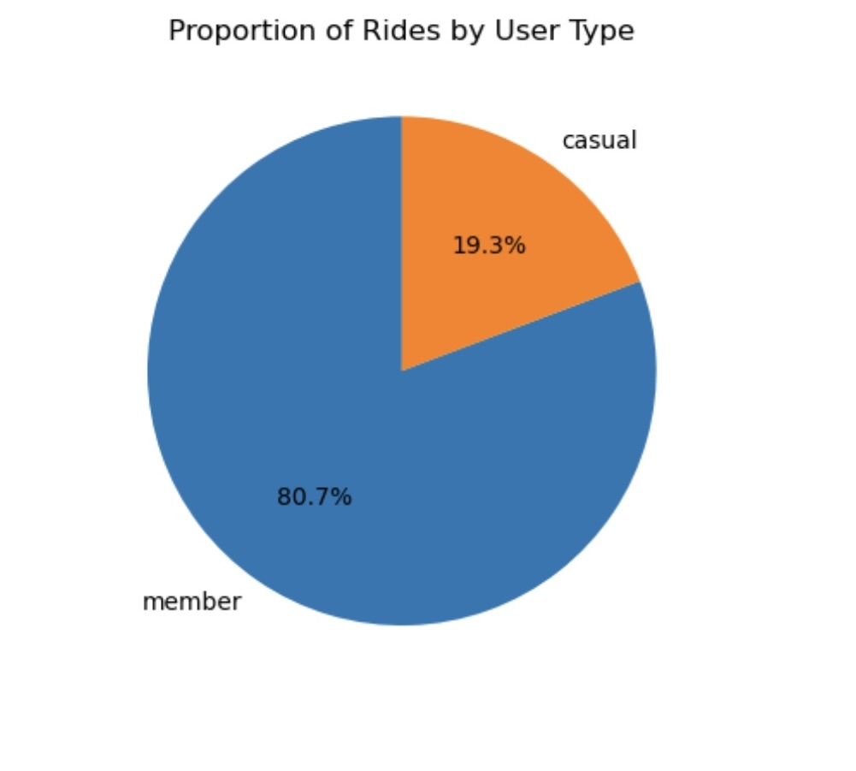
ANALYSIS SUMMARY

Slide 7
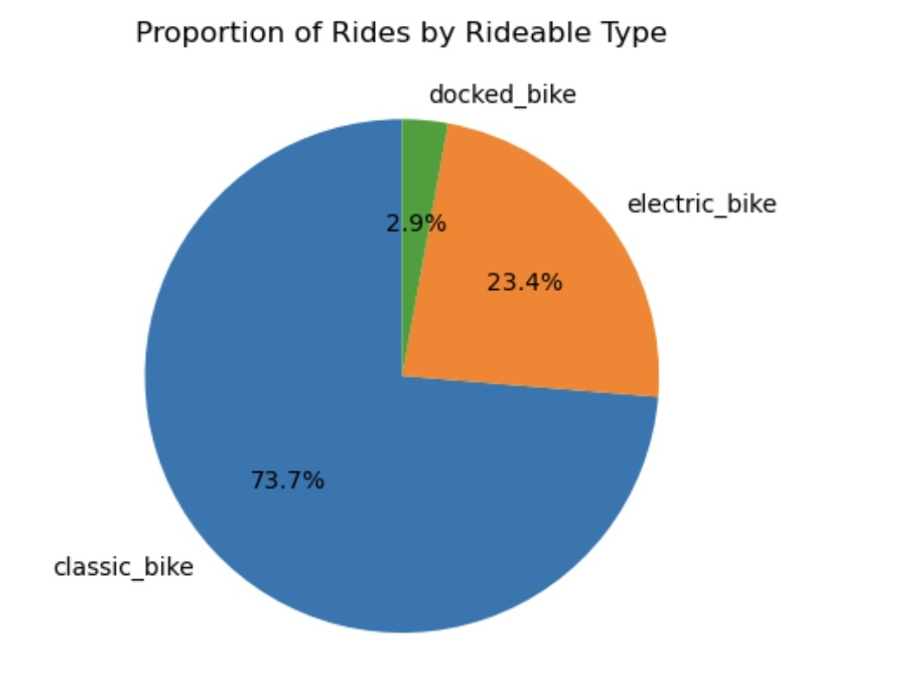
RIDEABLE TYPE

Slide 8
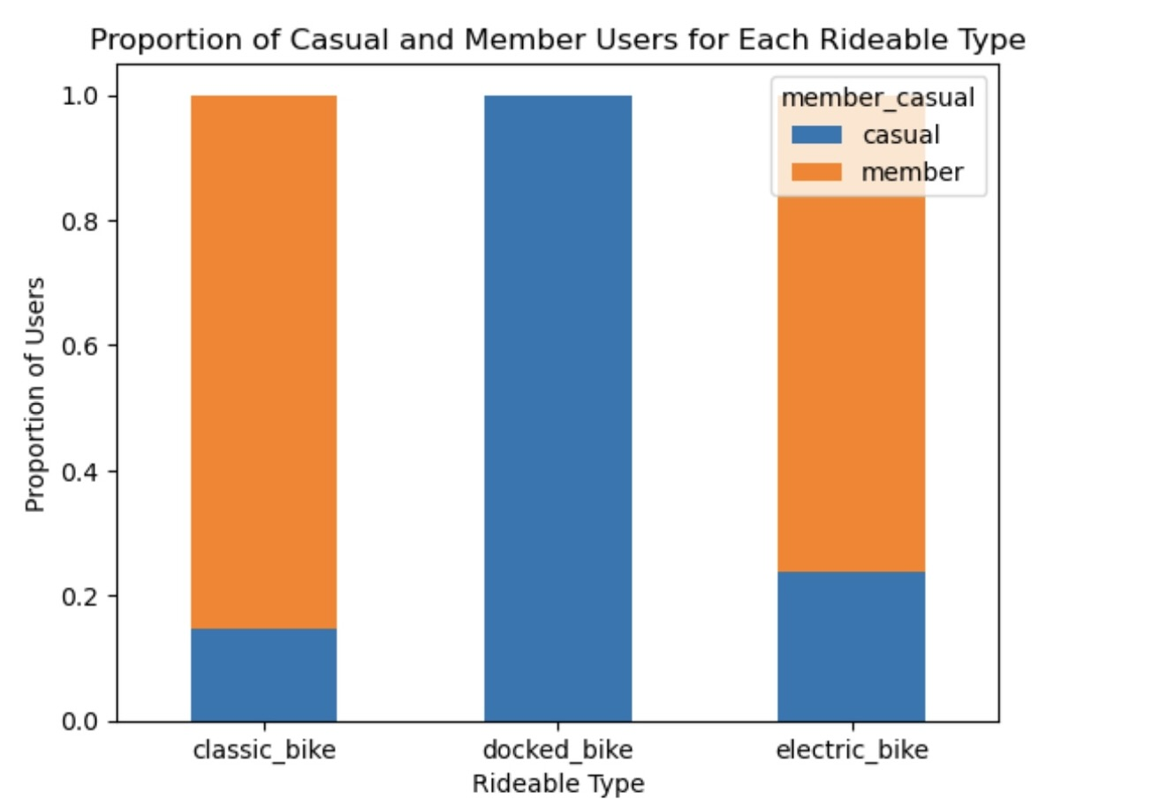
RIDEABLE TYPE BY BOTH USERS
Non-members and members both use e-bikes and classic bikes, with a roughly 60-40 split favoring members. Docked bikes show a member-specific preference, while casual riders don't have a strong preference for bike types.

Slide 9
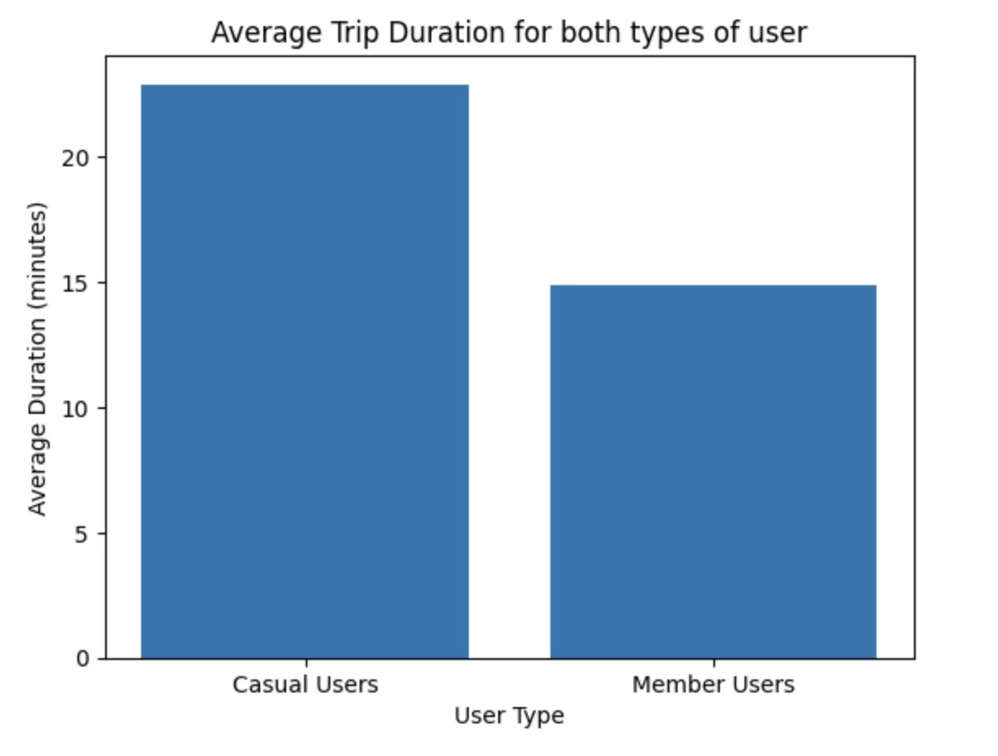
Average trip duration for casual and member user
According to the bar graph, casual users' typical travel times are around one-third longer than those of member users.

Slide 10
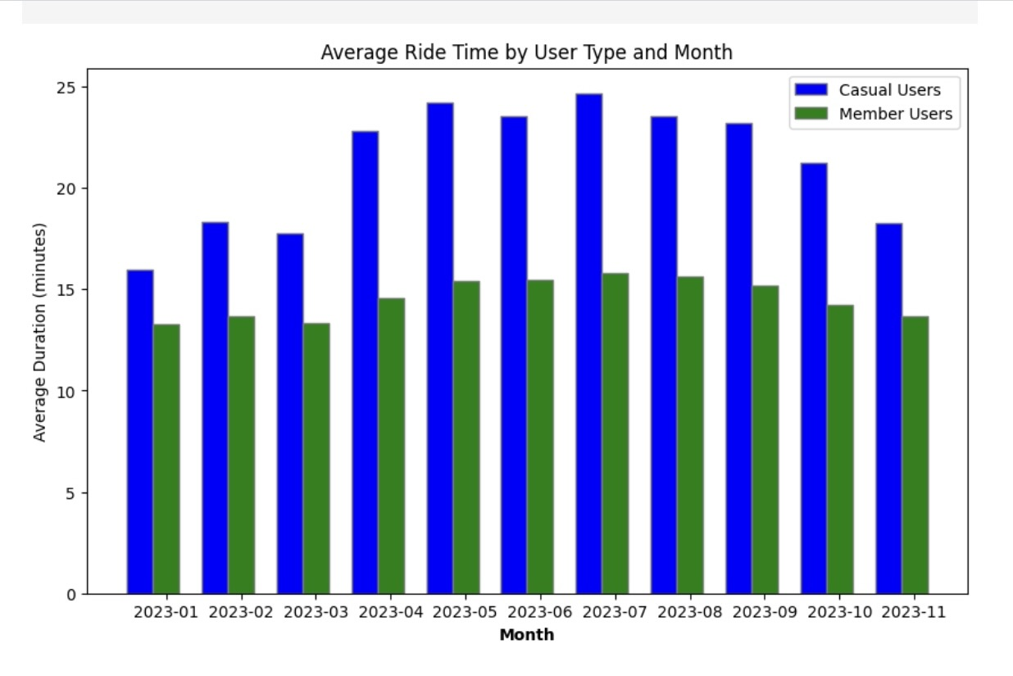
Average trip duration by month for casual and member user
Compared to members, casual users ride for longer on average throughout all months.

Slide 11
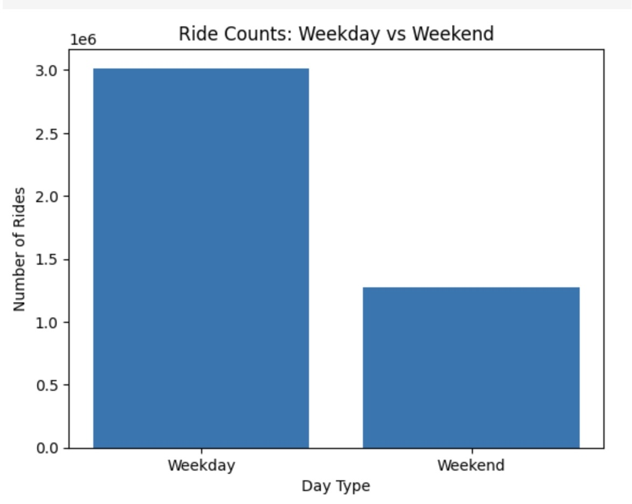
Ride in Weekday VS weekend
The graph indicates that both members and casual riders use the service 2.5 times more on weekdays than on weekends. This suggests that bikes are primarily used for weekday commutes rather than weekend leisure travel.

Slide 12
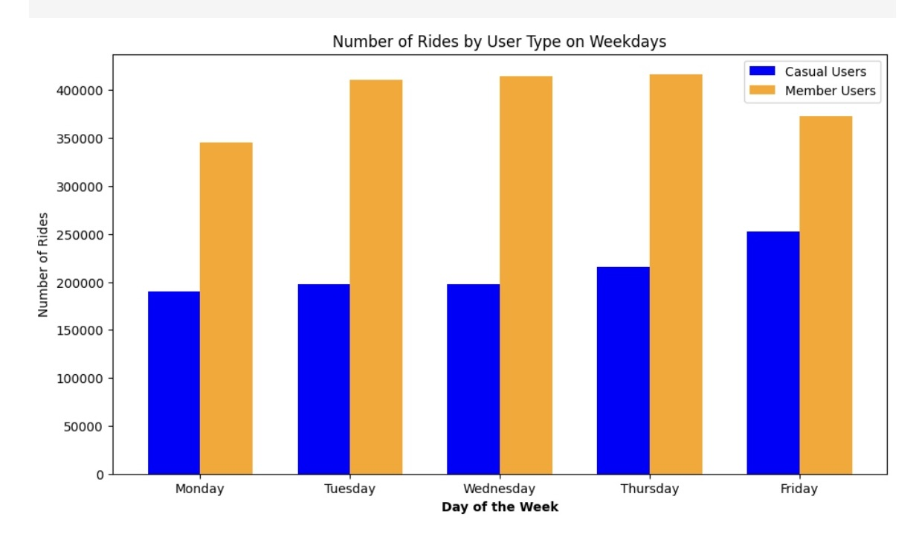
Ride in Weekday for both types of users
Members ride twice as often as casual users on weekdays

Slide 13
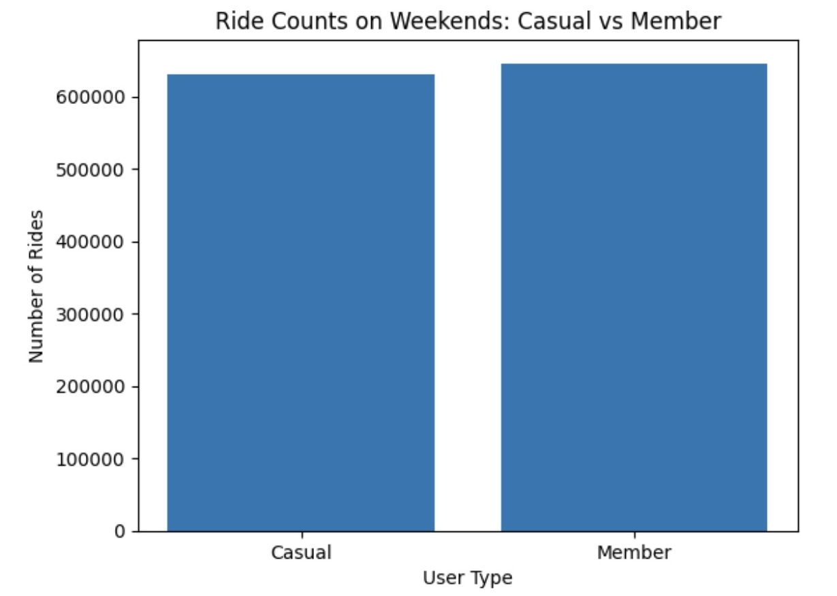
Ride in Weekend for both types of users
The second graph shows that weekend rides are roughly equal for both casual and member users, indicating that both groups enjoy using bike-sharing services for recreational purposes.

Slide 14
Questions
Question 1
How do annual members and casual riders use Cyclistic bikes differently?
In terms of total rides and ride time, our annual members use the Cyclistic bike sharing service often and reliably..
Conversely, casual riders don't use the bike regularly or often enough.It seems sense, then, that they would not want to convert to the yearly membership plan. Despite this, compared to yearly members, casual riders prefer to ride inconsistently, going on lengthy weekend rides that we believe are enjoyable and relaxing.

Slide 15
Question 2
Why would casual riders buy Cyclistic annual memberships?
To convert casual riders into annual members, Cyclistic should emphasize:
Cost savings compared to other transportation.
Health benefits of regular cycling.
Eco-friendly nature, reducing pollution.
Avoiding traffic congestion.
Promote the idea of using Cyclistic bikes to establish daily routines and planned travel, appealing to those seeking a structured lifestyle.

Slide 16
Conclusion
Annual members likely use the bike-sharing service regularly for commuting and daily schedules, while casual riders tend to use it more recreationally, with longer trip times and more frequent weekend use.

